Slide 1
IDEAL-Game Final Meeting 28th- 30th of November 2022, Germany; Paderborn
Last steps to do until the end of the project
University of Paderborn, Chair Business and Human Resources Education II Prof. Dr. Marc Beutner

Slide 2
IDEAL-GAME
Last steps to do until the end of the project
IDEAL-GAME –
Final Meeting
Host: University of Paderborn, Germany
28th – 30th of November 2022
Project Number: 2020-1-DE01-KA203-005682
Notes:
Okay, lets move on to the next agenda item: What’s laying ahead of us?
In a short summary, I will once again present the main construction sites. I may have to adapt the slides, as a lot of new things have now been adapted here.

Slide 3
Overview – Intellectual Outputs
Notes:
So we have this 5 IOs. And currently all IOs are running or even finished yet.

Slide 4
Project timeline - IOs
Intellectual Outputs of the IDEAL GAME project
IO1
01-09-2020 to 28-02-2021
Complete
IO2
01-10-2020 to 31-07-2022
Ongoing
IO3
01-06-2021 to 20-05-2022
Complete
IO4 01-01-2022 to 01-08-2022
Ongoing
IO5 01-03-2022 to
31-08-2022
Ongoing
Start of the project
September
2020
- Finish - End of the project December 2022
December 2020
April
2021
August
2021
December
2021
April 2022
August
2022
Notes:
IO1 has been completed for some time, IO2 is currently being worked on, accompanied by the survey, IO3 seems to be completed in time, but a few games and learning scenarios are still missing. IO4 and IO5 need to be completed in the coming weeks.

Slide 5
Last steps – Summary IO2
Please have a closer look into the workplan to get further details for next project activities and its deadlines!
Activity 6: Translation
6.1) Translation of text elements that are displayed within the tool | UPB, UPIT, WSEI, UD, UDIMA | Until 30/08/2022 |  |  | Not necessary
6.2) Integration of translated text elements | IK, UPB | 30/08/2022 |  |  |  | Not necessary | Not necessary | Not necessary | Not necessary
Activity 7: Showcasing the tool
7.1) Dissemination of tool | All partners | Until 31/10/2022
Notes:
This slide gives us an overview of what we still have to work on. Fore more details, please see the work plan.

Slide 6
Last steps – Summary IO3
Please have a closer look into the workplan to get further details for next project activities and its deadlines!
Activity 6: Translation
Translation of Games and Learning Scenarios | The self-created games should be available in the national language as well as in English
Notes:
This slide gives us an overview of what we still have to work on. Fore more details, please see the work plan.

Slide 7
Last steps – Summary IO4
Please have a closer look into the workplan to get further details for next project activities and its deadlines!
Activity 1: Didactical handbook for lecturers
Writing the parts of handbook | All partners
Translation of book into national language | All partners
Creation of book layout and design | IK

Slide 8
Last steps – Summary IO4
Please have a closer look into the workplan to get further details for next project activities and its deadlines!
Activity 2: Tool handbook for lecturers
Writing the parts of handbook | All partners
Translation of book into national language | All partners
Creation of book layout and design | IK

Slide 9
Last steps – Summary IO4
Please have a closer look into the workplan to get further details for next project activities and its deadlines!
Activity 2: Tool handbook for students
Writing the parts of handbook | All partners
Translation of book into national language | All partners
Creation of book layout and design | IK

Slide 10
Last steps – Summary IO5
Please have a closer look into the workplan to get further details for next project activities and its deadlines!
Activity 1: Policy Paper
Writing parts and providing to UPIT | All partners | 30.06.2022 | ✓ | ✓ | Not necessary
Writing Policy Paper | UPIT | 30.07.2022
Translation of Policy Paper | UPB, UPIT, WSEI, UD, UDIMA | 30.08.2022
Creation of layout and graphics | IK | 30.09.2022
Activity 2: Layman´s report
Writing Layman´s Report | UPIT | 30.07.2022
Translation of Policy Paper | UPB, UPIT, WSEI, UD, UDIMA | 30.08.2022
Creation of layout and graphics | IK | 30.09.2022

Slide 11
Last steps - Summary
Please have a closer look into the workplan to get further details for next project activities and its deadlines!
IO2: Development of the Creator Tool
Translation & Showcasing the Tool
IO3: Creation of OER Serious Games as well as learning materials and implementation strategies
Translation of Games and Learning Scenarios
IO4: Development of Books (Didactical handbook, tool handbook for lecturers and students)
Writing parts and Translation of the books
IO5: Policy Paper and Layman‘s Report
Translation of the Reports
Notes:
This slide gives us an overview of what we still have to work on. Fore more details, please see the work plan.

Slide 12
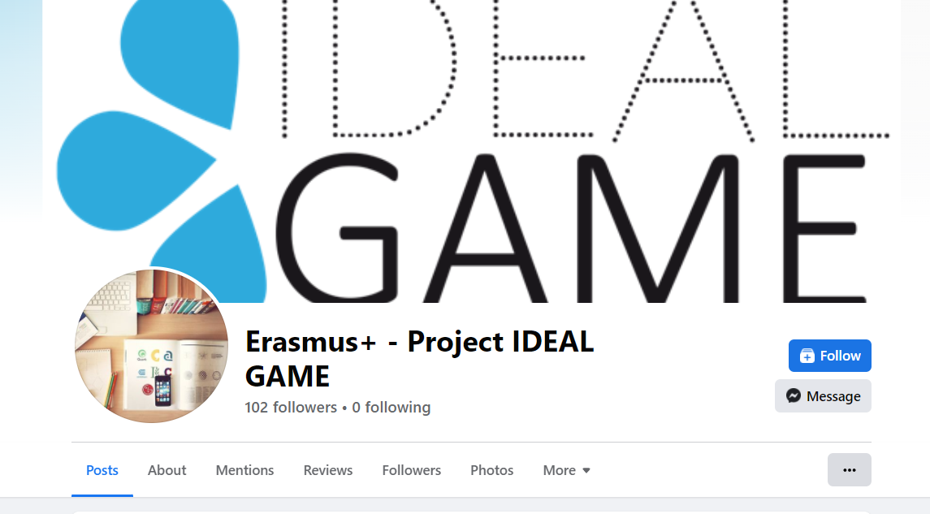
Dissemination
Please disseminate the project and their results broadly.
Feel free to contact us for more dissemination ideas
Website: https://ideal-game.eduproject.eu/
Facebook: Erasmus+ - Project IDEAL GAME
Notes:
Please also continue your dissemination activities. If you have not yet done so. Connect with us on Facebook.

Slide 13
Contact
Marc Beutner University Paderborn, Warburger Str. 100 33098 Paderborn, Germany Marc.Beutner@uni-paderborn.de
https://wiwi.uni-paderborn.de/department5/wirtschaftspaedagogik-prof-beutner

Slide 14
Thank you very much for
your attention!

