Slide 1
Current Status of IDEAL GAME in the countries
SPAIN
Universidad a Distancia de Madrid (UDIMA)

Slide 2
Project activities in Spain
IO1:
Translation of 1st Newsletter and Flyer into Spanish.
Translation of Questionnaire into Spanish.
Conducting field & desk research: we 136 answers from Spain.
Collecting best practice learning and teaching resources.
Writing of research report.
Translation of summary research report into Spanish.

Slide 3
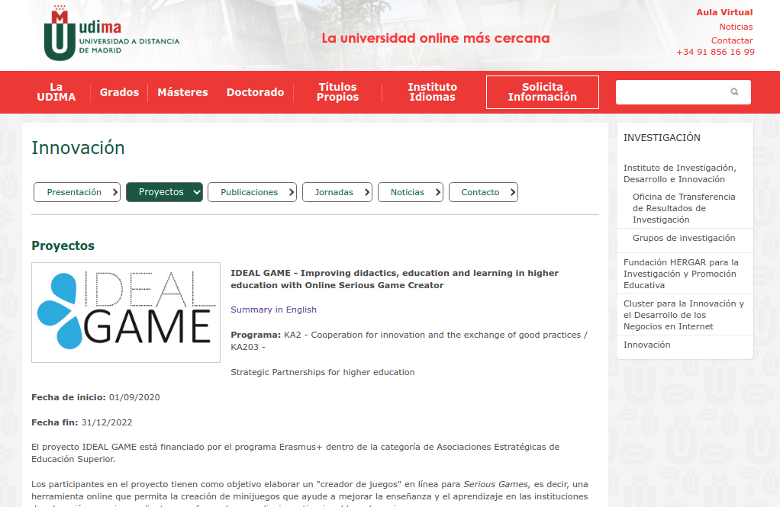
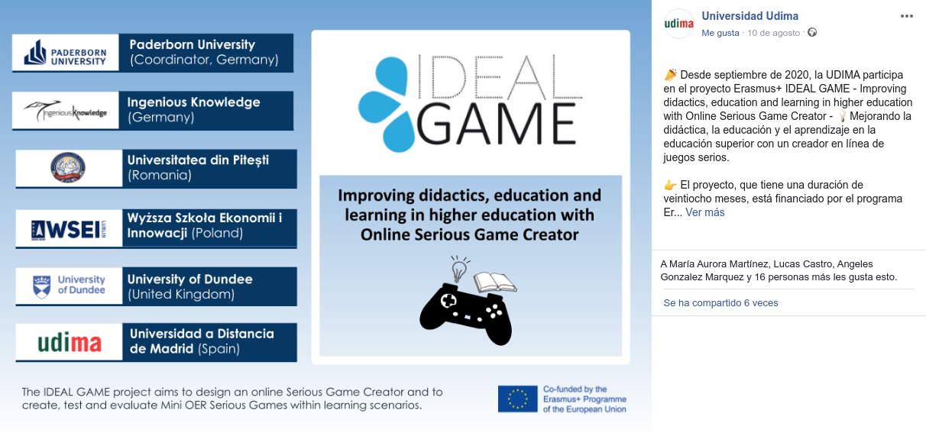
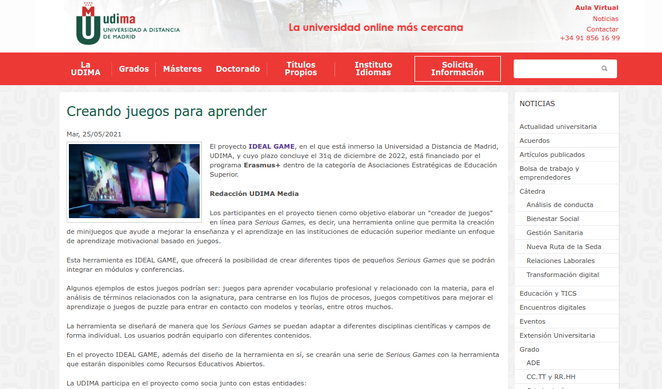
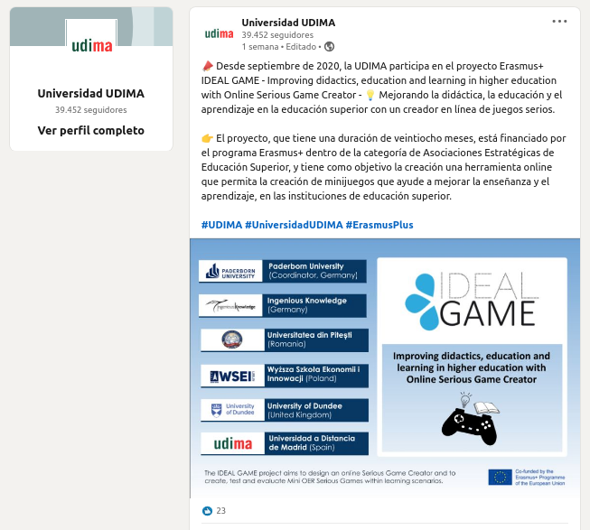
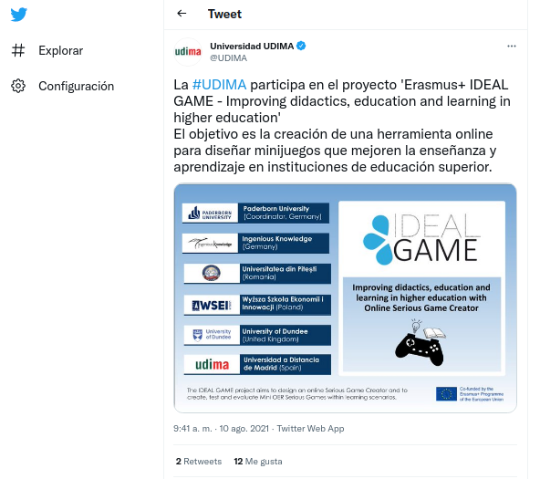
Project activities in Spain
Dissemination activities:
Publication of the project description on the udima website.
Publication in the news section of the udima website. (25/05/2021)
Post publication on:
Facebook (10/08/2021, 19 likes, 6 shares)
Linkedin (10/08/2021, 23 likes)
Twitter (10/08/2021, 12 likes, 2 rt)
1
2

Slide 4
Contact
Ana Landeta ana.landeta@udima.es
Silvia Prieto
silvianazareth.prieto@udima.es
Guillermo Abia
guillermo.abia@udima.es
Universidad a Distancia de Madrid (UDIMA)

Slide 5
Thank you very much for
your attention!

